Slide 1

Structure Reconstruction from Multi-view Fisheye cameras
A Structure from Motion Approach
KIKI YAW SARPONG
12/9/2020

Slide 2
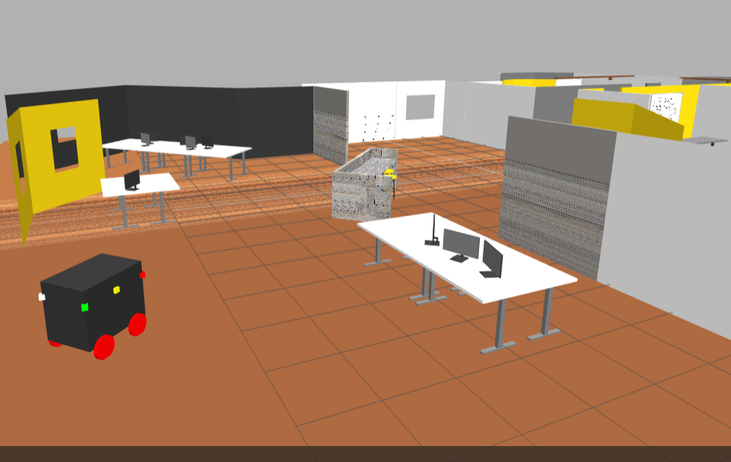
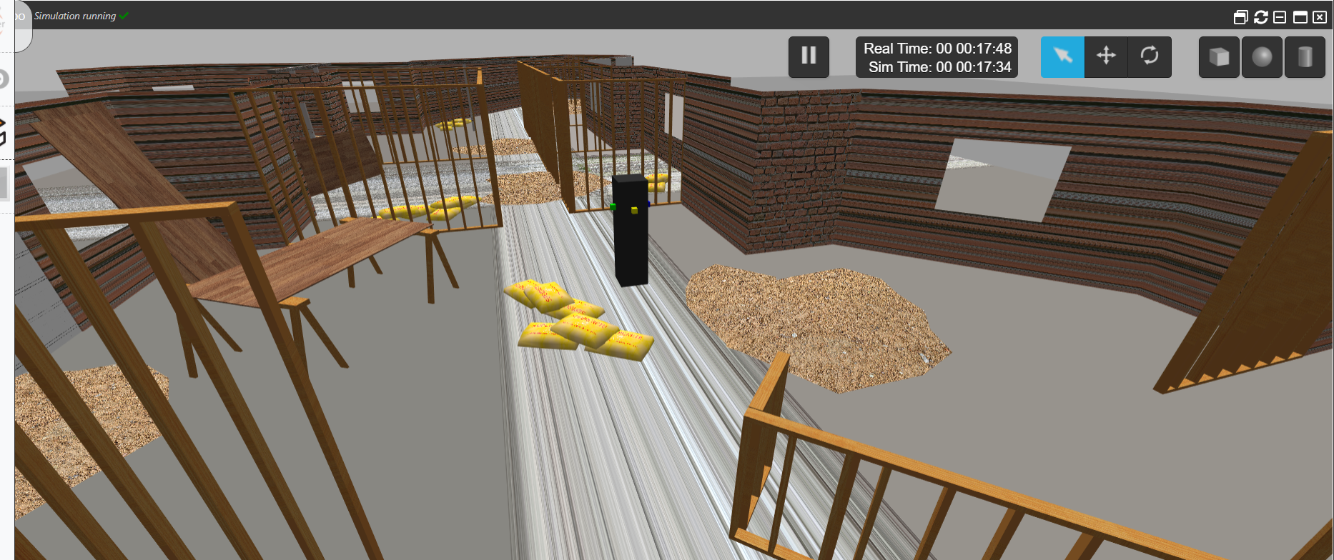
Project
Approach
Experimented with four or more fisheye cameras
Worked with static and moving robot models
Tried out different gazebo environments
Decided on final environment based on complexity, educational factor, etc

Slide 3
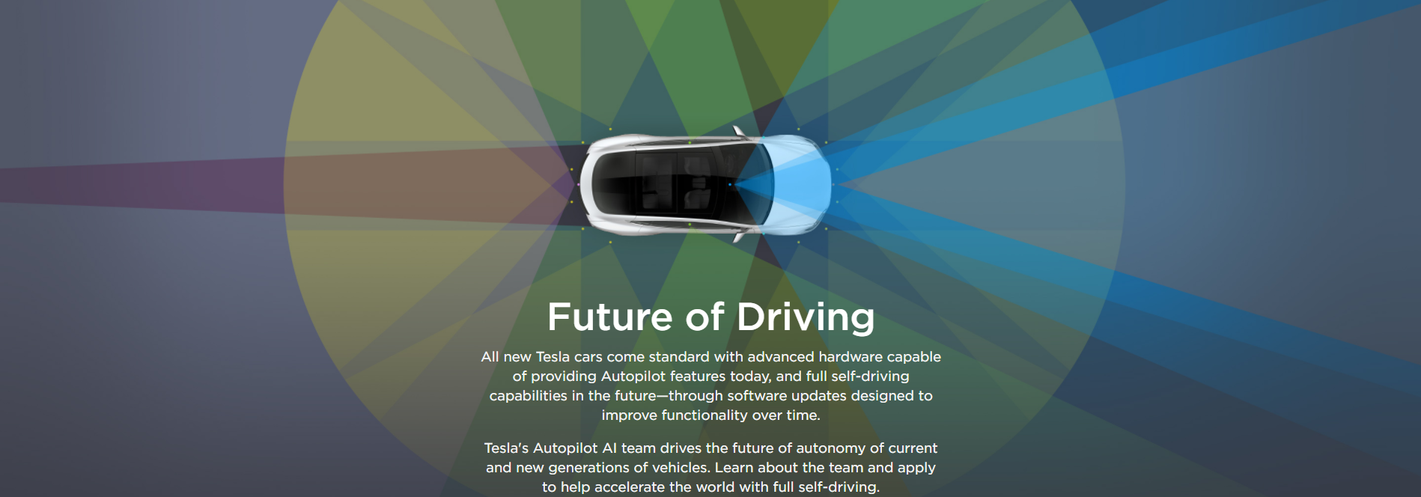
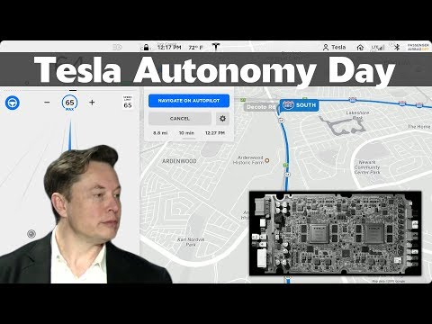
Project Inspiration

Slide 4
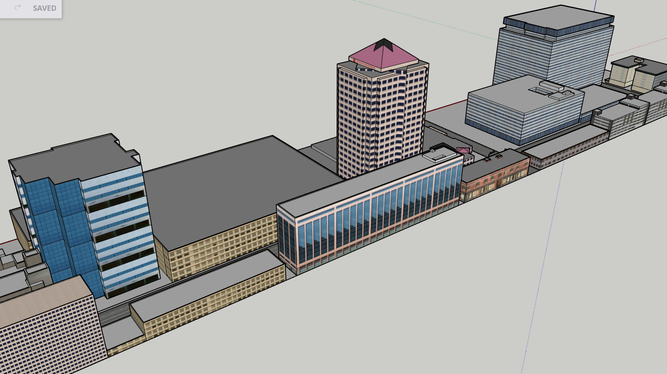
Final Project Model
City environment model to be reconstructed in camera view.
Model contains just building features with similarities of a city but not populated.

Slide 5
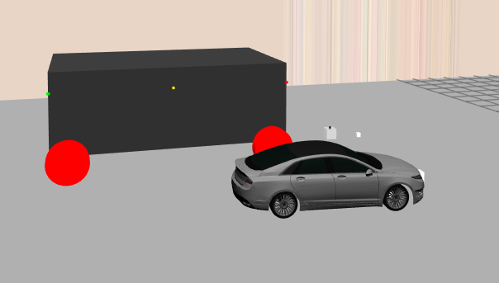
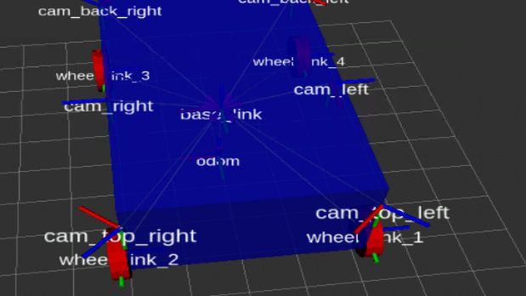
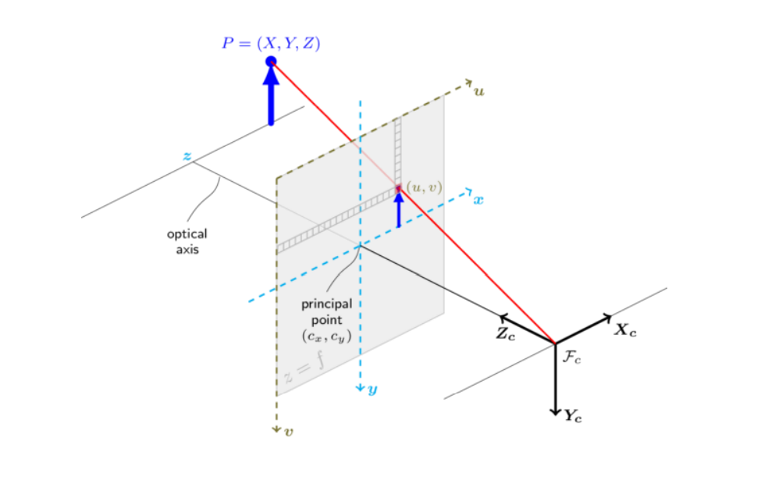
Robot model
Robot has 6 (180-170 degree) fisheye cameras
Robot speed - 0.03 m/s
City to robot scale is a bit off to allow for better feature extraction
More realistic car mesh for robot model not used due to scaling issues and extra time needed to create an upscaled car mesh

Slide 6
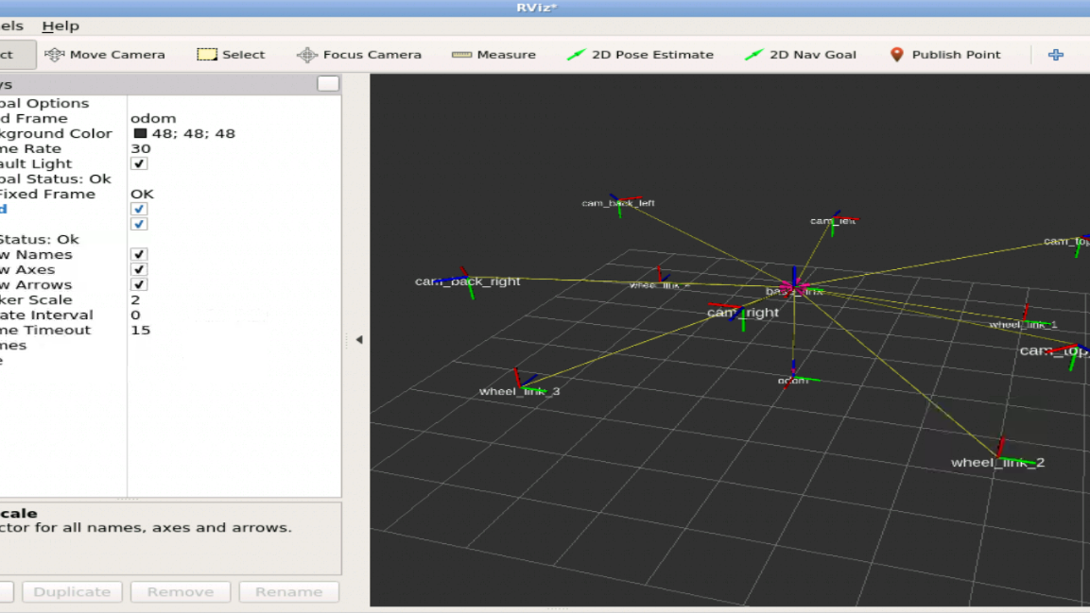
Robot TF description
Image displaying the various transformations of the various links in the robot model.

Slide 7
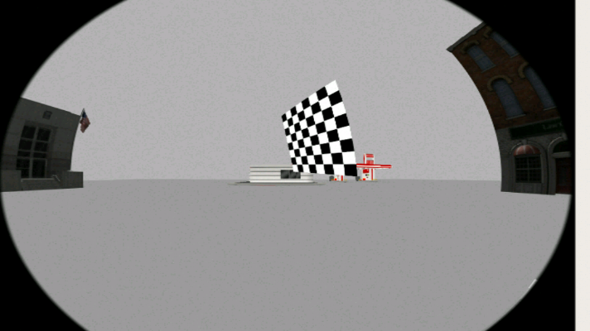
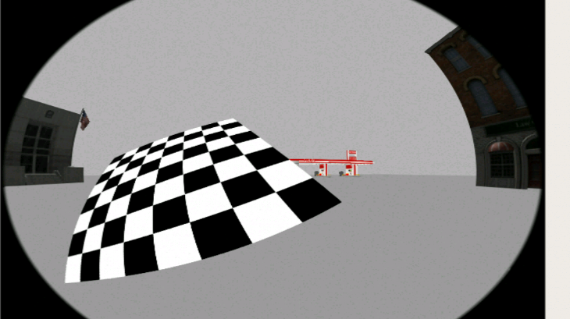
Calibration of fisheye Cameras
Calibrating all 6 fisheye cameras by taking multiple pictures of the checkerboard plane with each camera and finding the camera intrinsics and distortion coefficients.

Slide 8
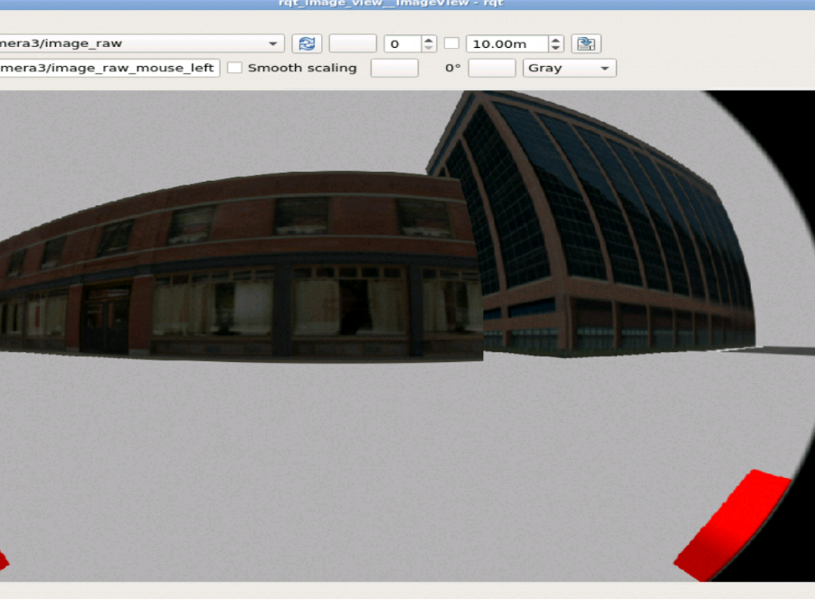
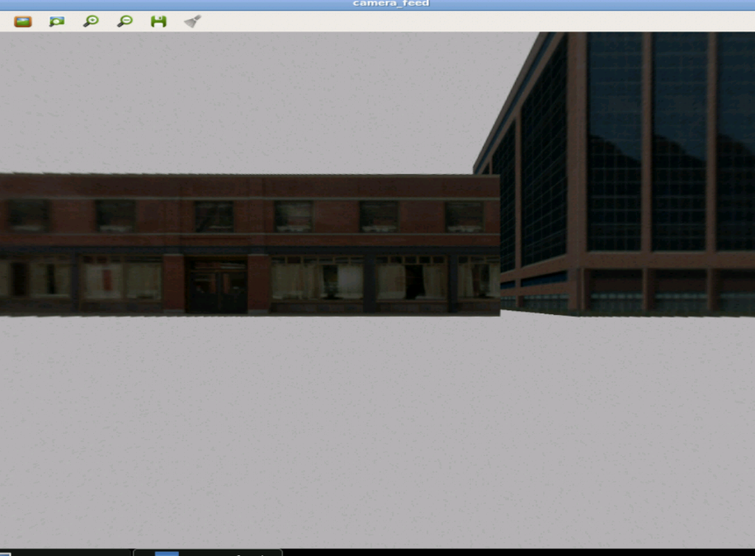
Image Undistortion

Slide 9
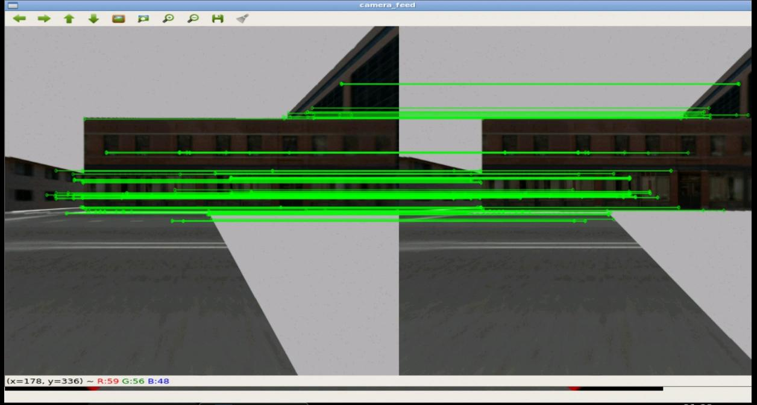
Feature
Matching

Slide 10
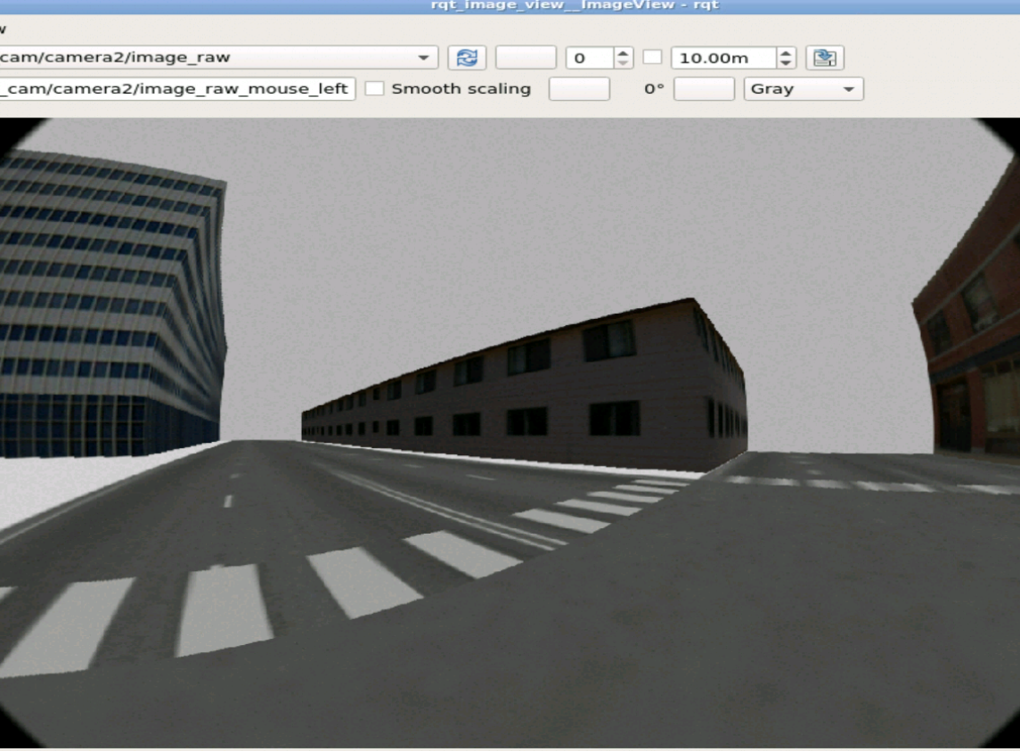
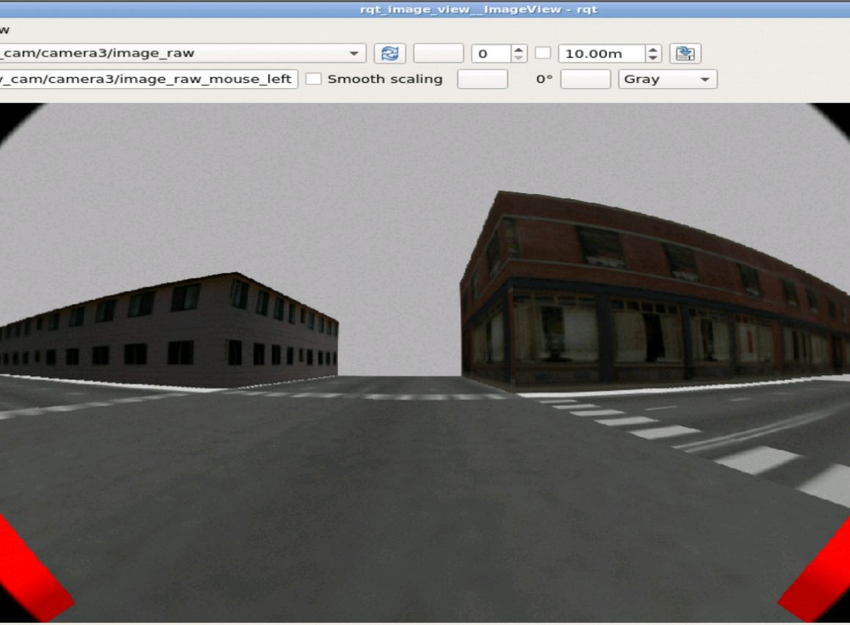
City view from fisheye camera perspective

Slide 11
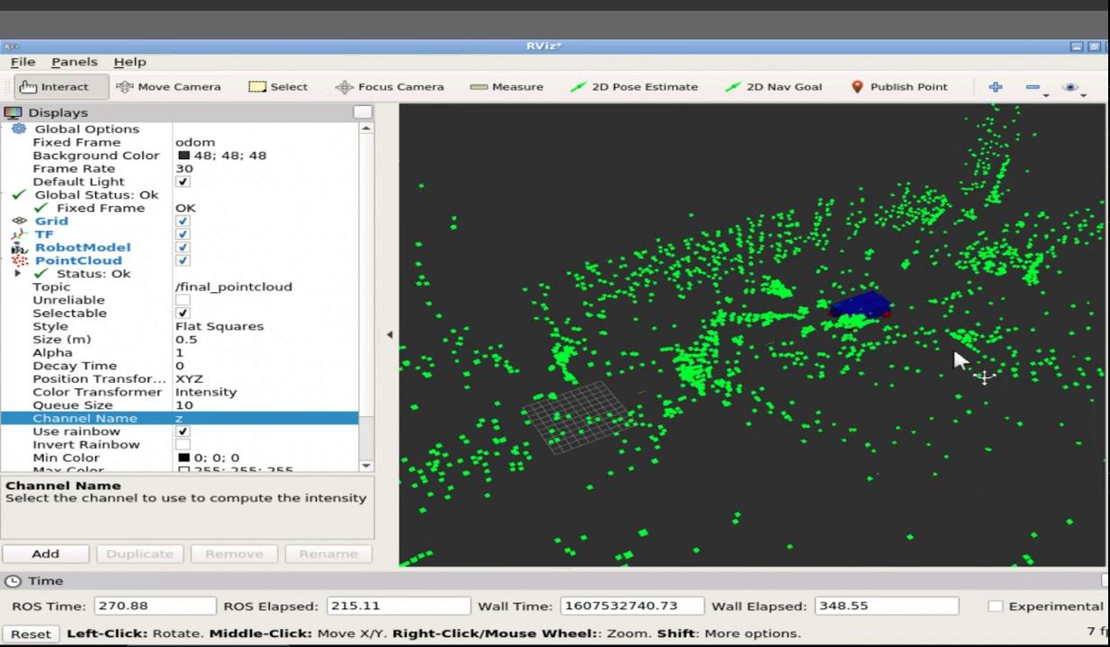
Map Result (Before bundle adjustment)

Slide 12
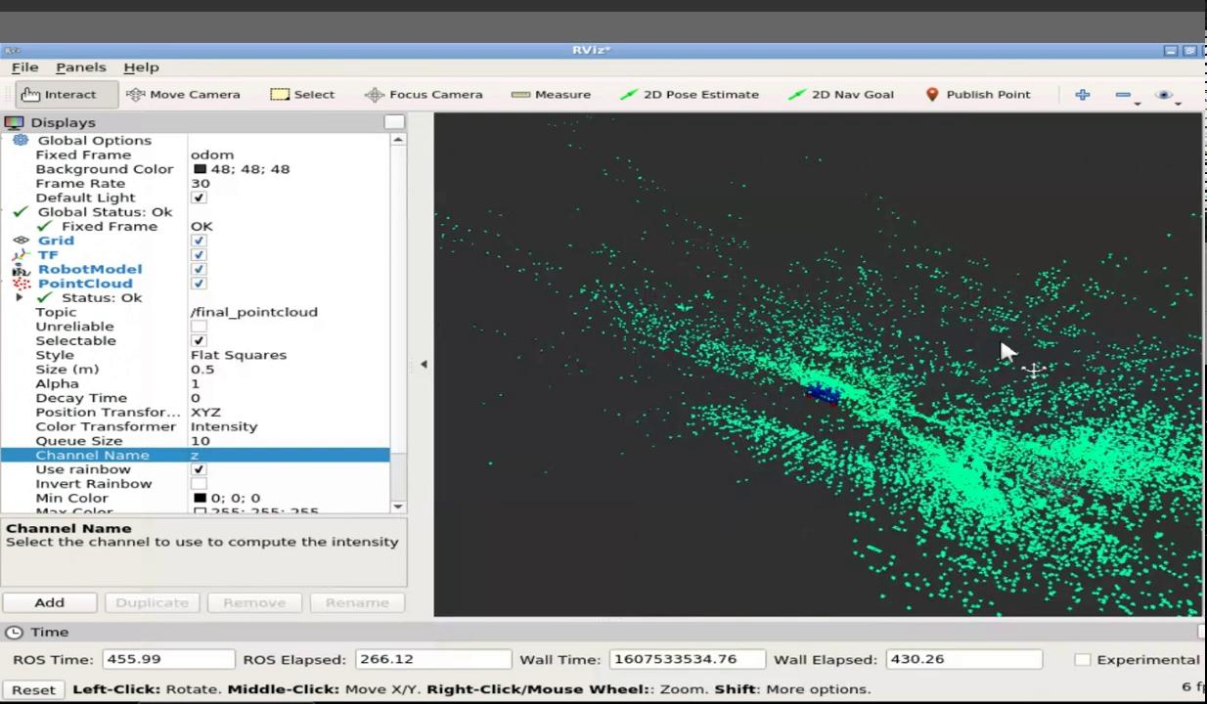
Map results (After bundle adjustment)

Slide 13
Reasons For Poor Map Attributes
Gazebo features tend to be scarce regardless of model
Scarce features in gazebo causes for a trade-off between RANSAC accuracy and point cloud density
Bundle adjustment tends to slow down the computation even more and accounts for a lag in point cloud mapping
Slow computational power and frame update speed (1 - 2 fps)
Robot model has to move slower to avoid losing rotation and translation in case consecutive frames are too far apart

